Slide 1
Water-Jug Problem
By
Madhuri Gupta
ASSISTANT PROFESSOR(CSE)
UTD,CSVTU, Bhilai

Slide 2
Water-Jug Problem
Water Jug Problem:
Problem: You are given two jugs, a 4-gallon one and a 3-gallon one.Neither has any measuring mark on it.There is a pump that can be used to fill the jugs with water.How can you get exactly 2 gallons of water into the 4-gallon jug.

Slide 3
Solution
The state space for this problem can be described as the set of ordered pairs of integers (x,y)
Where,
X represents the quantity of water in the 4-gallon jug X= 0,1,2,3,4
Y represents the quantity of water in 3-gallon jug Y=0,1,2,3
Start State: (0,0)
Goal State: (2,0)
Generate production rules for the water jug problem

Slide 4
Production Rules
Rule | State | Process
1 | (X,Y | X<4) | (4,Y) {Fill 4-gallon jug}
2 | (X,Y |Y<3) | (X,3) {Fill 3-gallon jug}
3 | (X,Y |X>0) | (0,Y) {Empty 4-gallon jug}
4 | (X,Y | Y>0) | (X,0) {Empty 3-gallon jug}
5 | (X,Y | X+Y>=4 ^ Y>0) | (4,Y-(4-X)) {Pour water from 3-gallon jug into 4-gallon jug until 4-gallon jug is full}
6 | (X,Y | X+Y>=3 ^X>0) | (X-(3-Y),3) {Pour water from 4-gallon jug into 3-gallon jug until 3-gallon jug is full}
7 | (X,Y | X+Y<=4 ^Y>0) | (X+Y,0) {Pour all water from 3-gallon jug into 4-gallon jug}
8 | (X,Y | X+Y <=3^ X>0) | (0,X+Y) {Pour all water from 4-gallon jug into 3-gallon jug}
9 | (0,2) | (2,0) {Pour 2 gallon water from 3 gallon jug into 4 gallon jug}
Production Rules

Slide 5
Initialization
Start State: (0,0)
Apply Rule 2:
(X,Y | Y<3) ->
(X,3)
{Fill 3-gallon jug}
Now the state is (X,3)

Slide 6
Iteration 1:
Iteration 1:
Current State: (X,3)
Apply Rule 7:
(X,Y | X+Y<=4 ^Y>0)
(X+Y,0)
{Pour all water from 3-gallon jug into 4-gallon jug}
Now the state is (3,0)

Slide 7
Iteration 2:
Current State : (3,0)
Apply Rule 2:
(X,Y | Y<3) ->
(3,3)
{Fill 3-gallon jug}
Now the state is (3,3)

Slide 8
Iteration 3:
Current State:(3,3)
Apply Rule 5:
(X,Y | X+Y>=4 ^ Y>0)
(4,Y-(4-X))
{Pour water from 3-gallon jug into 4-gallon jug until 4-gallon jug is full}
Now the state is (4,2)

Slide 9
Iteration 4:
Current State : (4,2)
Apply Rule 3:
(X,Y | X>0)
(0,Y)
{Empty 4-gallon jug}
Now state is (0,2)

Slide 10
Iteration 5:
Current State : (0,2)
Apply Rule 9:
(0,2)
(2,0)
{Pour 2 gallon water from 3 gallon jug into 4 gallon jug}
Now the state is (2,0)
Goal Achieved.

Slide 11
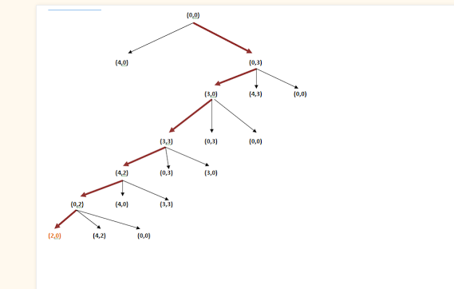
State Space Tree

Slide 12
Thank You

